Slide 1
Give
Thanks
Dear Teacher,
“… God’s children are like stars that shine brightest in the darkest skies; like the chamomile, which, the more it is trodden down, the faster it spreads and grows.…”
“… We should never forget that the prison, the scaffold, and the stake were stages in the march of civil and religious liberty which our forefathers had to travel, in order that we might attain our present freedom.…
“… Before our children remove their religious connexions, … —before they leave the old paths of God’s Word, …—before they barter their birthright for a mess of pottage—let us… let them know that they are the sons of the men ‘of whom the world was not worthy,’ and whose sufferings for conscience’ sake are… monumentally recorded.”
Happy Thanksgiving from
The Foundation for American Christian Education
Notes:
NOTE TO THE TEACHER:
The slides have been created with standard fonts; however, there may be formatting issues that arise when you open this presentation on your computer. Please review the slides to be sure that the text remains on the slide field. If not, you may need to resize the fonts or otherwise adjust the text before presenting.
The slide narration is printed in the notes section of each slide. Within the text of the narration, symbols like this () are embedded to show when to trigger animations on each slide by pressing the ENTER or  keys or by using a remote device. Some of the animations are underlines for emphasis. If the text does not translate to your computer well, you may need to adjust these or delete them to avoid confusion.
Depending on your presentation mode, you may be able to see the Presenter’s Notes, or you may print the notes by selecting NOTES PAGES on the print window. If you choose to print the script, check that all the notes are captured; they may be outside of the printable space. If so, you may change the font size or cut and paste the notes to a Word Document.
⬥ Advance to next slide
SOURCES:
Quote of John Overton Choules*, preface to The History of the Puritans; or, Protestant Nonconformists, by Daniel Neal*, rev. ed., 1843; repr. of Dr. Toulmin’s edition, ed., John O. Choules, New York: Harper and Brothers, Publishers, 1855, 1: v–vi, vii. As published in
Hall, Verna M.: The Christian History of the Constitution of the United States of America, Vol. I. Christian Self-Government. Founders Edition. Chesapeake, VA: Foundation for American Christian Education, 2006, 183.

Slide 2
Twelve Going On Twenty
A True Story of
William Bradford
by Aunt Carolyn
(a.k.a. Mrs. Dayton Hobbs)
Young William Bradford lives the
Christian Principle of Self-government, and so can you!
“Out of the mouths of babes and infants You have established strength…”
Psalm 8:2
Notes:
Today I am going to tell you a story of Young William Bradford. I am using a wonderful version of the story told by a lady named Aunt Carolyn; her real name is Mrs. Dayton Hobbs, and she loves to tell stories of Jesus and His people.  She has titled her story, “Twelve Going On Twenty.”
How old are you now? In how many years will you be twelve? Show me with your fingers. I want you to keep this number of years in your mind because they will pass quickly and I want you to use those years well and to the glory of God. (Young children can be helped to calculate this by holding up ten fingers, then folding down the number of fingers that represents their current age, and finally adding two fingers back again.)
You may have heard of William Bradford. As an adult, he was a leader of the Pilgrims who first brought the seed of Christian Self-Government and liberty of conscience to America. He and the small group of Pilgrims established a colony at Plymouth in what later became the Massachusetts colony and then eventually the state of Massachusetts in the United States of America.
But Mr. Bradford had to be prepared for this important role in history, that is His-story. And did you know that much of his preparation came when he was a young person just about your age? Yes, history tells us that William Bradford was a faithful young man of God even by the age of twelve. So I have subtitled  our story today, “Young William Bradford lives the Christian Principle of Self-Government, and so can you!” I am reminded of the scripture in God’s Holy Word in Psalm 8 verse 2, “Out of the mouths of babes and infants You have established strength…” As you listen to the story today, I want you to imagine how young William Bradford’s life was his word made flesh just like Jesus was the Word of God made flesh. In other words, how we live our lives tells others what we believe. I think you’ll see that young William Bradford believed in Jesus Christ and wouldn’t have his mind changed no matter what others said or did. I hope that the same is said about you.
Well, let’s learn about how William allowed God to prepare him.
⬥ Advance to next slide
The publisher has generously given permission to FACE to use the chapter “Twelve Going On Twenty” from Wally the Wallaby and Other Short Stories, as told by Aunt Carolyn with slight alterations. Copyright 1990 by Gospel Projects, Inc. (877) 626-7030; childrensbibleclub.com

Slide 3
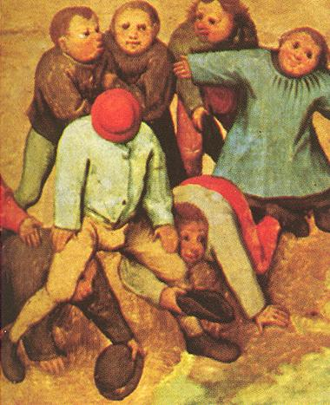
“Ousterfield, Osterfield—who knows where the poor orphan Bradford was born?”
Notes:
(Read the dialog with four or five mocking voices.)
“Austerfield!” chanted one fellow.
“No, it’s Ousterfield!” taunted another.
“Ah, plain Osterfield, it is!”
The scoffing boys threw their taunts at young William Bradford as he passed. Although the sickly boy ignored them, the jeers continued relentlessly.
◆ “Ousterfield, Osterfield—who knows where the poor orphan was born?”
“Why, in Yorkshire, don’t you know?”
“Yorkshire? Of course! Yorkshire Pudding!” The insults continued.
“Yorkshire Pudding to be sure? Where else would such a pious fanatic come from?” And the taunting boys laughed raucously as they ran away.
Leading Ideas for Reasoning, Relating and Reflecting:
Has anyone ever mocked, taunted, or made fun of you? How does it make you feel? Knowing how it makes you feel when you received taunting, do you want to be the one making someone feel that way by making fun of him or her?
Have you ever suffered teasing because you are a Christian? Teasing, though it hurts our heart, is a very mild form of persecution. Many Christians suffer far greater effects for their faith. As Christians we are to expect and to be joyfully willing to share in the sufferings of Christ.
Why do people make fun of others? What must be our Christian response to those who taunt us?
Jesus was made fun of, ridiculed, and mocked, too, for many reasons throughout his life. Just like the boys were teasing William Bradford about being from the little farming parish of Austerfield in nearby Yorkshire in England, Jesus was mocked for being from Nazareth in Galilee because Nazareth was considered an insignificant town of insignificant people. John 1:46, 7:41, 42, 52
⬥ Advance to next slide

Slide 4
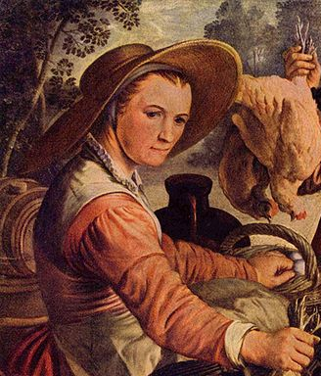
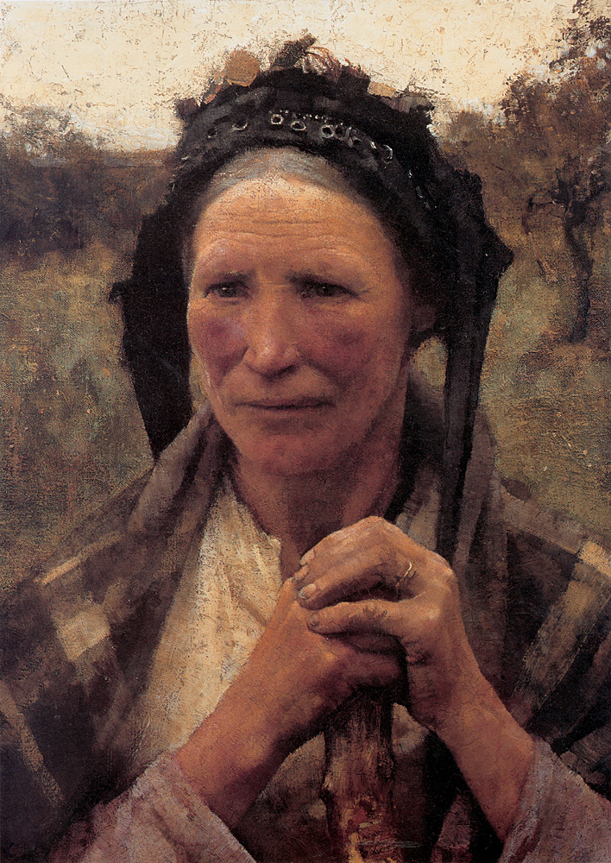
“Aye, it is not an easy day in which we live. All this revolting against the Church of England is enough to threaten the throne itself.”
“But methinks there is something to what the Separtists espouse.”
Notes:
(Most of the story is told as a conversation between two women: Old Madam Winston and Dame Percival. The lines of Old Madam Winston are underlined as voice prompts.)
Old Madam Winston raised up from cultivating her herb garden and peered over the picket fence at her neighbor. “’Tis a shame the way the boys mock the Bradford boy.”
“Aye, it is not an easy day in which we live. All this revolting against the Church of England is enough to threaten the throne itself. For my part, I shall stay by the Church regardless of what they say,” said Dame Percival confirming her oath with a stamp of her hoe.
“And well you may, but methinks there is something to what the Separatists espouse. Bradford has joined the ranks of the dissenters to be sure. He has a head full of ideas—he and that [Elder] Brewster, who seems to have taken him under his wing.”
(Separatists, the Church of England, and Elder Brewster are explained in upcoming slides.)
⬥ Advance to next slide

Slide 5
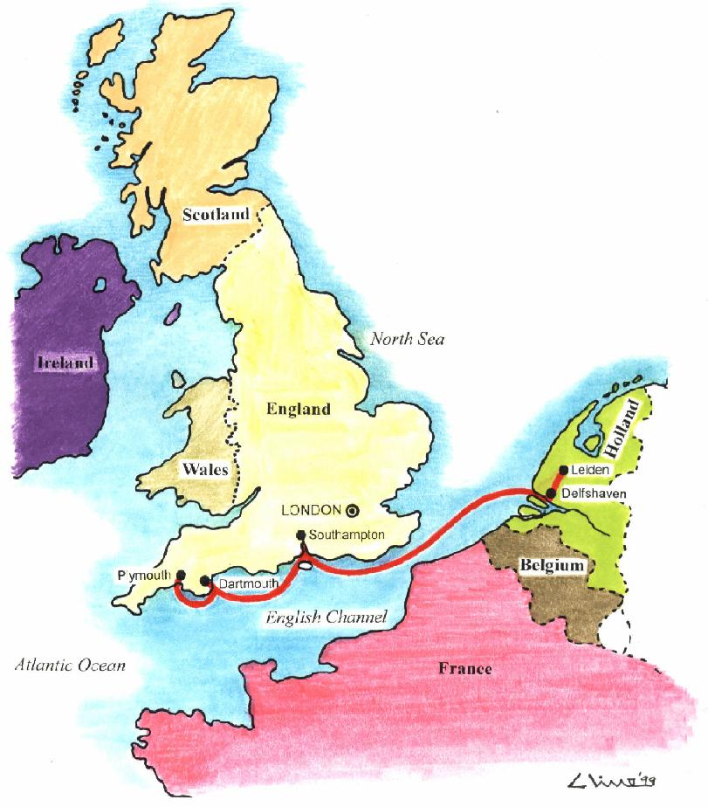
“…but since they got a hold of copies of the Holy Bible printed in English they find every occasion to study, discuss, exhort, and preach. Young William has earned the reproach he receives along with the other Separatists who persist in meeting at Scrooby.”
Scrooby
Separatists
Notes:
“Aye, ‘tis a wonder they have become such fast friends, Brewster being so much older than William, but since they got a hold of copies of the Holy Bible printed in English they find every occasion to study, discuss, exhort, and preach. Young William has earned the reproach he receives along with the others who persist in meeting at  Scrooby.”
Leading Ideas for Reasoning, Relating, and Reflecting:
What do you take every occasion to do? Do you willingly choose to spend it like young William did in the reading and study of God’s Word and in learning about His creation? Or do you do something else with your time? God created time, so He owns it. He has given each of us a portion of His time. We must account for how we spend it. William did not allow the distractions of childhood to steal God’s time. As a matter of fact, we know from history that young William was a sickly boy and had to spend many days inside, even in bed, but he afterwards thankfully said that his illnesses kept him from the “vanities of youth” and in the Word of God.
What does it mean that “Young William earned the reproach he received?” Reproach is another word for the mocking and teasing that the other boys were heaping upon William. They had called him a “pious fanatic”. The world does not love Jesus; they are enemies of God. Doesn’t is say much of young William’s Christian character and self-government that even as a very young man others could see his faith in his life.
William was a ‘Separatist’. This was a term used for those of this time period in England who were reading the Word of God now available in their own language and in books they could afford and actually carry (history of the Bible in English), and who wanted to apply the Word of God to every aspect of their lives including how they worshiped God. You see the Church of England or Anglican Church was the national church and the head of it was the monarch, the king or queen, and this church had some rules and interpretations of religion that were not Biblical. But, it was illegal to be English and to live in England and not attend this national Church. These professors, as they called themselves, chose to separate from the Church, so they were called ‘Separatists’.
⬥ Advance to next slide

Slide 6
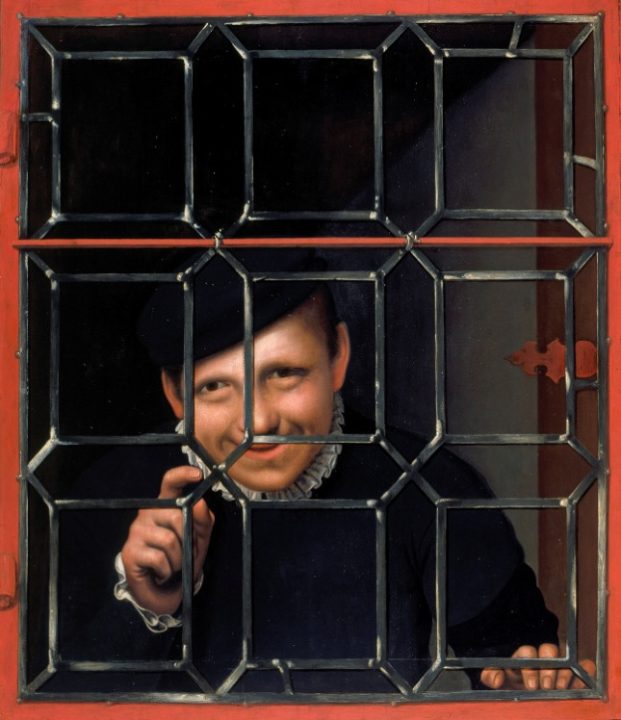
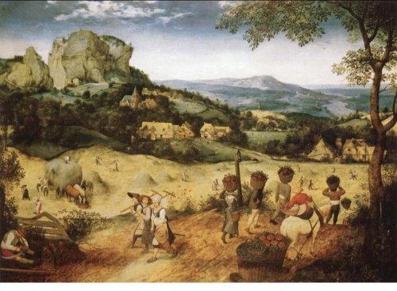
“His uncles taught young William to work in the fields and to keep the herds. They trained him well in husbandry.”
Notes:
“Well, he comes from good stock,” Madam Winston continued. “His father, Robert Bradford, was an upstanding, respected yeoman of Austerfield, aye, one class next to the queen’s gentry. He owned and farmed broad, rich English acres. When William was born it seemed good prospects for a life of opportunity, wealth, and prestige lay ahead of him.”
“You say so,” replied Dame Percival. “Methinks fate has taken a different turn to look at him now.”
“Ah, one heartache after another has fallen upon the child. His dear father died when William was only a babe of one year. He was left alone with his mother. Yet one would think he might yet have a stable childhood, but, dearie, wold you believe, in just three years she married again and packed William off to live with his grandfather, William Bradford for whom the boy was named?”
“Tch, tch, what a shame, but I suppose his grandfather loved him.”
“Indeed, but the poor man himself passed on in just three years [and young William’s mother within a year of that, too], and once again the lad was left orphaned. He had a good inheritance, but, of course, a boy of seven could not be left to himself.  Alas, his uncles were pressed to take responsibility for him. They have taught him to work in the fields and to keep the herds. They have trained him well in husbandry.”
“Well, that is good. He can make a good living and be a respectable citizen.”
Leading Ideas for Reasoning, Relating, and Reflecting:
William’s skills of husbandry were a providential blessing to the Pilgrims in New England. In addition, he applied the principles of agricultural husbandry—God’s principles—to the Christian care and brotherly love of the Pilgrim sheep given to his care.
God’s design for the family and the role of kinsmen is essential to the body of Christ.
⬥ Advance to next slide

Slide 7
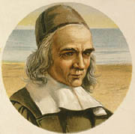
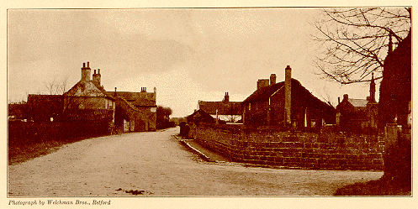
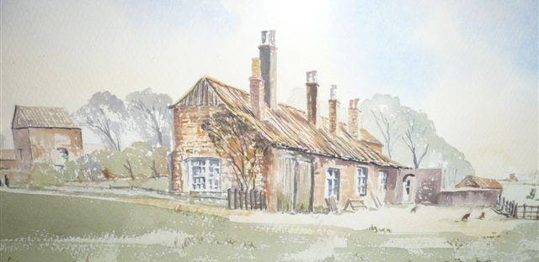
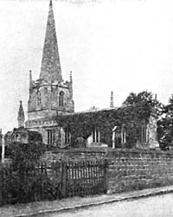
“William and the small group who are…bold in these beliefs… that the Bible is the inspired Word of God and that they need neither Pope nor the Bishop to interpret it but may themselves be taught by the Holy Spirit.”
Notes:
“Oh, indeed. There is nothing lacking in his ability, but since he has become one of the Separatists even his uncles rebuke him sternly and warn him of the shame, poverty, and reproach they see resulting from his stand. Yes, dearie, I fear boisterous, laughter-loving Merrie Ole’ England has not proved very merry for William and the small group, who are becoming more outspoken and bold in these beliefs of theirs—that the Bible is the inspired Word of God and that they need neither the Pope nor the Bishop to interpret it but may themselves be taught by the Holy Spirit.”
Leading Ideas for Reasoning, Relating, and Reflecting:
Scrooby was a little village in the north of Nottinghamshire county in England. Who would have thought that such a small, quiet hamlet would become a hotbed for growing the seeds of religious freedom and liberty of conscience? But God has always providentially used the weak, small, and insignificant to confound the mighty. That is His way, for when we are weak, He is strong. You might consider yourself small, weak, and of little importance, and sometimes the world may make you feel this way. But don’t lose heart, God is our Overcomer and still uses the small to do His mighty works.
Every town or parish had at least one church that represented the Church of England or Anglican religion where people were expected to go and participate in the traditions and ceremonies, sometimes there was very little reading of God’s Word, especially in English, or preaching by a pastor, but attendance was mandatory. You could lose all you owned and even be arrested for not attending church because it meant you were also not obeying the king. In those days, it was more important to obey the king that to obey Jesus, the King of kings. There was no religious freedom to go to church where you wanted.
But many people, including this man William Brewster, were studying God’s Word and coming under the conviction of the Holy Spirit that they needed to reform their lives to live according to God’s ways and not man’s ways—not even the king’s ways.
They separated from the Church of England and began worshiping and studying together in homes since all the church buildings belonged to the Church of England. Elder Brewster opened his home or manor house to the little group of Separatists at Scrooby. But it wasn’t long before Elder Brewster and others found themselves in trouble with the Church of England and with the Queen Elizabeth and later with King James. They eventually had to leave England for the Lord’s sake, and we should thank God that they had the courage to do so.
⬥ Advance to next slide

Slide 8
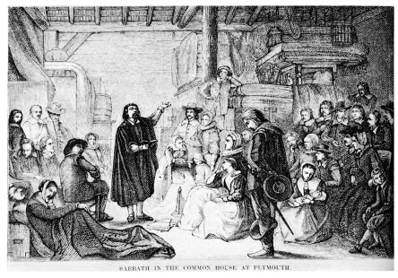
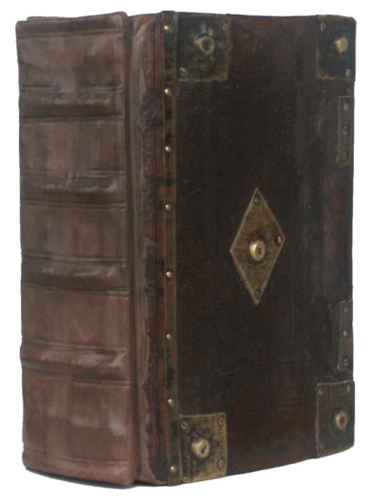
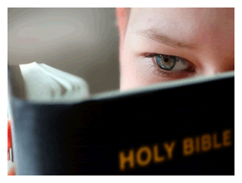
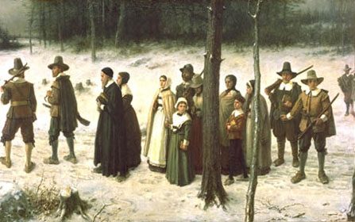
“By the time William was twelve years of age he was
deep in the Scripture,
wanted only those of like faith for his companions,
and would walk eight miles to hear the preaching.”
Notes:
“Oh, The Book, The Book! That’s all they seem to want to know,” declared Dame Percival. “I was told that  by the time William was twelve years of age he was  deep in the Scripture,  wanted only those of like faith for his companions,  and would walk eight miles to hear the preaching.”
Leading Ideas for Reasoning, Relating, and Reflecting:
The Book of the Pilgrims was the Geneva Bible. Not only was it written in English, but it was a “life application” Bible. Included in it were marginal commentaries that helped the readers reason the application of the principles of Scripture to areas of living, including government. It taught the Pilgrim that God’s form of government is Christ governing in the heart of the individual and that each individual was responsible to live according to his conscience. It helped them understand that they could not submit to the national church as a matter of conscience. Reprints of the Geneva Bible are readily available today.
Young William Bradford, because of his personal study of the Word, also understood God’s principle to be in the world and not of the world. Bradford chose friends and companions who would strengthen his faith, not weaken it with temptation, misguided counsel, or poor character and reputation. He understood that entering into covenant relationships, like friendships, required the consent of one’s conscience. He guarded his consent carefully. In addition, William Bradford lived a life and had a character that others would want in their friends.
How many adults, let alone youth, willingly and happily submit to faithful ATTEND-ance at church? The services of the Separatists were often five hours or better of diligent Scripture reading and study. Would you wake up early enough and walk eight miles to go to church? Would you engage your mind in reading, study, and discourse in the Word of God for five hours? Would you seek in every way to apply what you learned to your life throughout the week? Yet, it was for these very acts of worship that the Pilgrim willingly forfeited his home, his livelihood, his family, and even his life to walk in the ways of God.
⬥ Advance to next slide

Slide 9
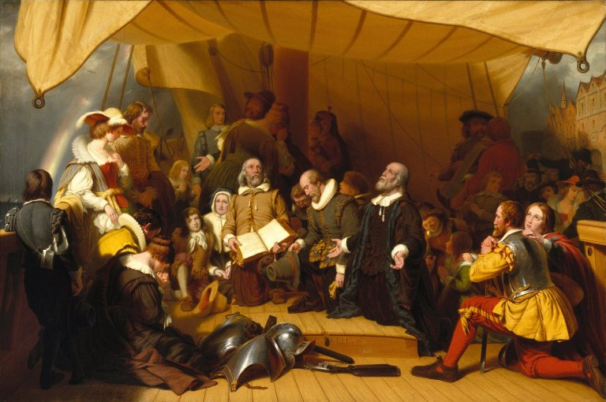
“William Bradford trusted Christ, determined to live by the Word of God, and chose to be counted with those who put their lives on the line for His cause.
As a YOUNG boy he dedicated his life to Christ and never turned back.”
Notes:
All the old English dames said about William was true. In spite of his difficult childhood, a fate that would have defeated many youngsters and made them either weak and dependent or rough and rebellious,  William Bradford trusted Christ,  determined to live by the Word of God, and  chose to be counted with those who put their lives on the line for His cause.  As a young boy he  dedicated his life to Christ and  never turned back.
Leading Ideas for Reasoning, Relating, and Reflecting:
William Bradford made internal decisions that were then made evident in his life. This is Christian self-government.
By age twelve, Bradford’s life had been so providentially prepared mainly through hardship, difficulty, and sacrifice that his character is defined by these words: trustworthy, determined, steadfast, faithful, dedicated, longsuffering. This is Christian character, and character is only formed in the Refiner’s fire.
God allowed Bradford to live for many more years to fulfill his calling as governor of Plymouth and author of his journal, “of Plymouth Plantation”, but even had Bradford died as a very young man, he would be able to say with Paul, “I have fought a good fight, I have finished my course, I have kept the faith. Henceforth there is laid up for me a crown of righteousness, which the Lord, the righteous judge, shall give me at that day; and not to me only, but unto all them also that love his appearing.” II Timothy 4:7, 8 Each of us, young and old, must live each day so that these verses can be our nightly prayer of thanksgiving.
⬥ Advance to next slide

Slide 10
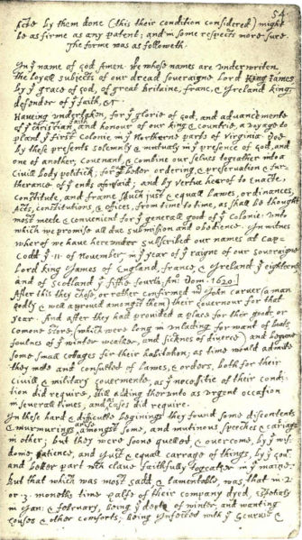
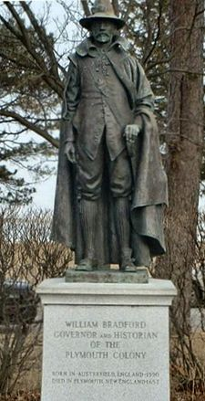
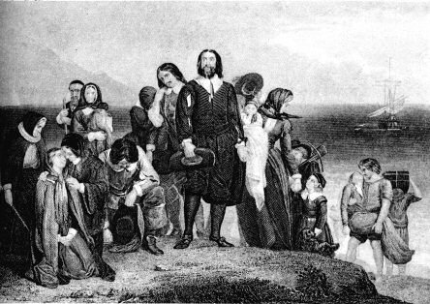

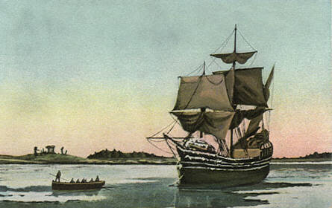
“Only eternity will tell the full impact of his life, testimony, and dedication to the Cause of Christ and the spread of the Gospel.”
Notes:
“Only eternity will tell the full impact of his life, testimony, and dedication to the cause of Christ and the spread of the Gospel.
“Boys and girls, [you] may also give [your] lives to Christ to live for Him and do His will. Do not wait until you are older. Do not let precious years be wasted. Make your life count for Him now.”
Leading Ideas for Reasoning, Relating, and Reflecting:
You can be a bright light for Christ NOW, even as a young boy or girl. You can be ONE SMALL CANDLE (Bradford’s quote is on the next slide).
What will His-story record of you and your contribution to God’s Gospel purpose? No good work done for the glory of God is insignificant. The bright light of your life will show someone the Way.
⬥ Advance to next slide

Slide 11
“Thus out of smalle beginings greater things have been produced by his hand that made all things of nothing, and gives being to all things that are; and as one small candle may light a thousand, so the light here kindled hath shone to many, yea in some sorte to our whole nation; let the glorious name of Jehova have all the praise.” -William Bradford
Notes:
Bradford was faithful to record the mighty works of God in the lives of the Pilgrims. He wrote a journal called “Of Plymouth Plantation” and this is one line from his work. As I read it, consider how your life can be a small beginning—one small candle for Christ:
◆ “Thus out of smalle beginings greater things have been produced by his hand that made all things of nothing, and gives being to all things that are; and as one small candle may light a thousand, so the light here kindled hath shone to many, yea in some sorte to our whole nation; let the glorious name of Jehova have all the praise.”
I want to tell you about another person who impacted the world at a young age. As a matter of fact, this young person was twelve, too.
⬥ Advance to next slide

Slide 12
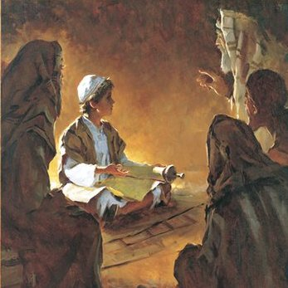
After three days they found Him in the temple, sitting in the midst of the teachers, both listening to them and asking them questions. And all who heard Him were amazed at His understanding and His answers.
When they saw Him, they were astonished; and His mother said to Him, "Son, why have treated us this way? Behold, your father and I
have been anxiously looking for You."
And Jesus said to them, "Why is it that you were looking for Me? Did you not know that I had to be in My Father's house?” Luke 2:46-49 (NASB)
Notes:
Jesus is fully God, yet he came to this world—and the Word was made flesh and dwelt among us. He came to this world as a baby and had a childhood, too. Throughout his life on earth he remained fully God, so he was sinless, but he was fully human, so he laughed and cried; he knew the pain of a hammered thumb in his father’s carpenter shop and the comfort of a mother’s hug. He knew laughter with good friends and to stay away from untrustworthy people. However, because he was born over two thousand years ago, he did not have bicycles, denim jeans, boxed cereal, or cold cans of soda. He never downloaded music to his MP3 player, played a video game, or surfed the internet. Because he was born into the Hebrew culture, he was early trained in the trade of his father Joseph, as a carpenter. He wouldn’t have known lazy Saturday mornings of cartoons, or summer camp, or soccer games, or family vacations. He would have known household chores, family duties, hard work, and faithful study in the temple. He would have been fully accountable before God by the age of twelve and ready to be commissioned into adulthood. Because he was a Jew, he would have celebrated the Passover in Jerusalem with his family, and that’s where our story begins: (Read Luke 2:40-52,  at verse 46).
⬥ Advance to next slide

Slide 13

How old are you?
Notes:
◆ “How old are you?”
You are not too young to decide for Jesus and allow Him to be your Savior and Lord. “Repent of your sins and trust Christ as your Savior today.”
You are not too young to study God’s Word and to amaze all who hear your understanding. “For out of the mouths of babes God has established strength and praise.”
You are not too young to determine to take up the Cause of Christ by living His Truth and loving others; to lift high the Cross of Christ by not being ashamed of your faith; and shine the light of Christ by sharing the Gospel message with others.
“Don’t put off your responsibility thinking there is a magic in the age of 18 or 21, that you will then decide what you will do with your life.”
You have life and breath now. You decide, like young William Bradford and young Jesus to be in your Father’s house and about His business.
“…Stand with and for God according to His Word. Put your life on the line for Christ while you are still young.”
Prayer:
Father, “we praise [You] for leading the Pilgrims in the founding of our great nation, and we commemorate the great sacrifices they made. William Bradford and other stalwart founding fathers gave their all to the cause of Christ and the Gospel.” I pray that these young men and women will be like young William Bradford and trust Christ, determine to live by the Word of God, choose to be counted with those today and throughout history who have put their lives on the line for Your cause, and who will dedicate their lives to You and NEVER TURN BACK. I pray that they have the courage to welcome the development of Christian character by doing hard things and Christian self-government by making right decisions. I pray that the light of their young lives will light many. I pray that even today, they will astound the world with their understanding of Your Truth and their conviction to walk in it. I look forward to what His-story will say of these young men and women. I commend them in the power of Your Spirit and in the Name of Your precious Son, Jesus Christ. Amen.

